Slide 1
ATL-IBM Kids Internship 2020 – Team 2
Project Code Name: SaMoSa
(Based on the theme: Sanitization, Masks & Social Distance)

Slide 2
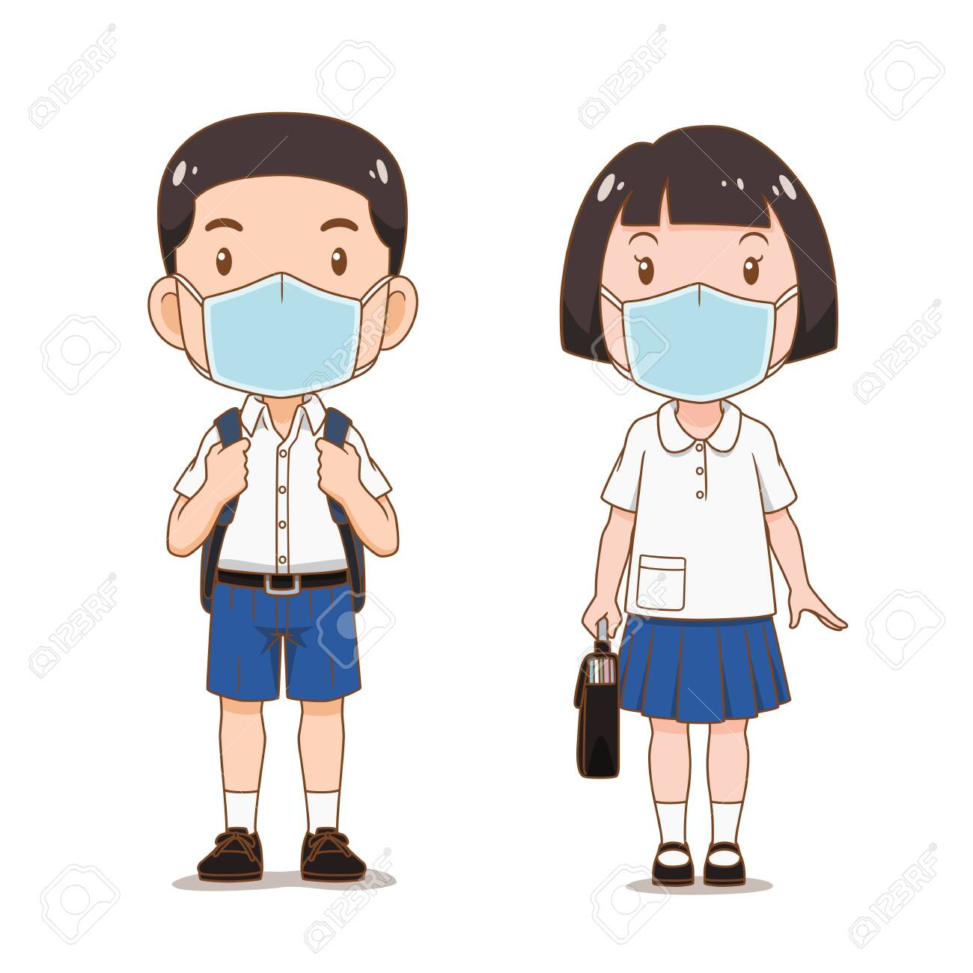


Problem & Motivation
Hello Prabhuti, How are you doing? It’s been a long time !!
Prabhuti
Hi Arkesh, I’m doing ok, just dragging along
Arkesh
Wwhhaat? You sound so dull, safe at home right? Then?
Yah, but pappa & bhayya go out for essentials. Worried about them?
They can reduce as much and wear masks while out na?
Many cases outside, we have no clue about them?
Govt is publishing the data on a daily basis, isn’t it?
Arrey, those are tested & known cases only. Many people might already have it. And they are roaming outside irresponsibly in groups, without masks. Risking others lives.
Hmmm, that’s a problem. Better to avoid or reduce going out.
Wish, it was possible. In our town no online delivery. Won’t know which shops are open, if they have masks, grocereies available. Lot of crowds, garbage thrown out in many places.
Arrey haan, itnaa dhyaan hi nahi diya. Ab mujhe bhi darr lag raha hai.

Slide 3


Fikar not… Here is the APP
Saavdhaan
Smart SaMoSa hi …
… samasya ka Samaadhaan!!!

Slide 4

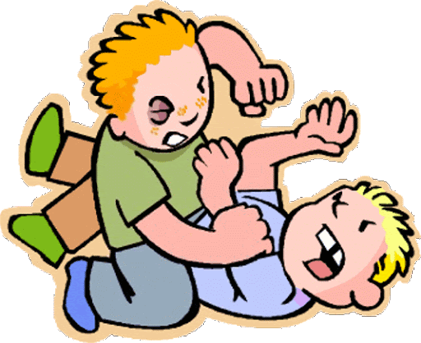
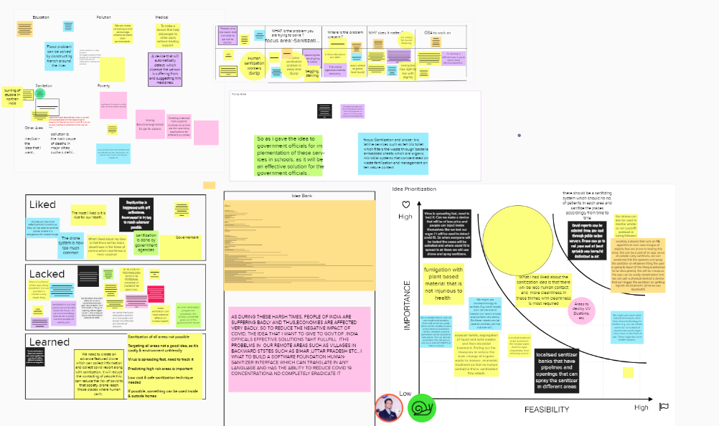

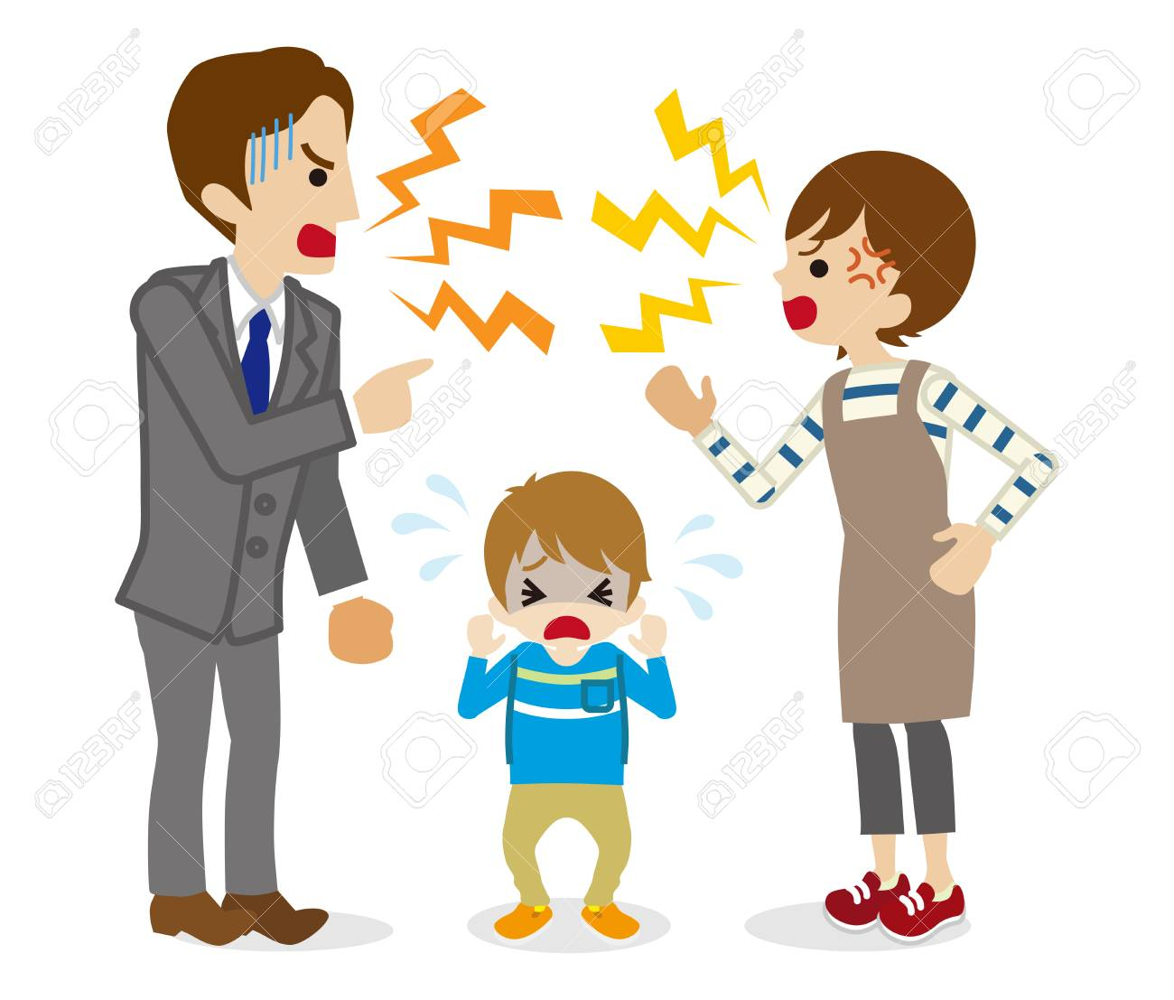


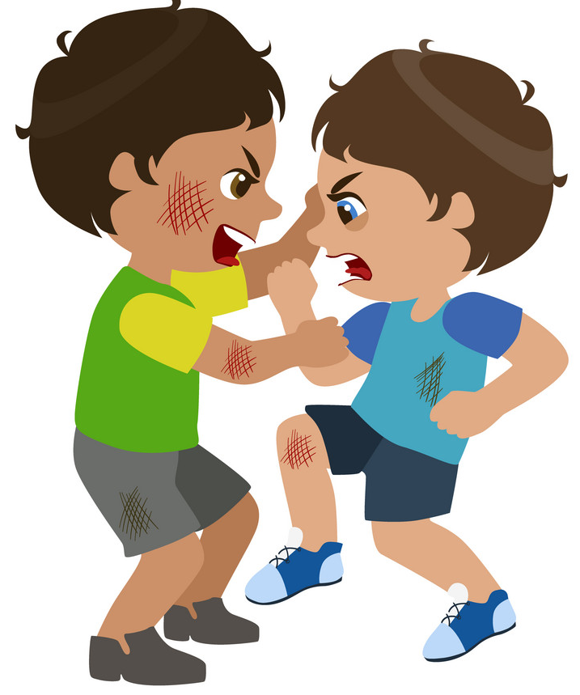
Brainstorming – Design Thinking

Slide 5
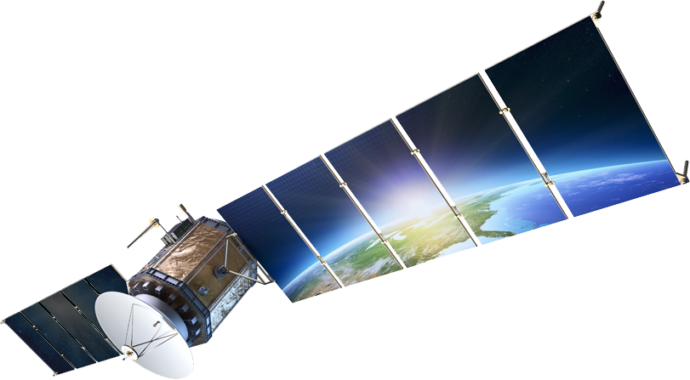
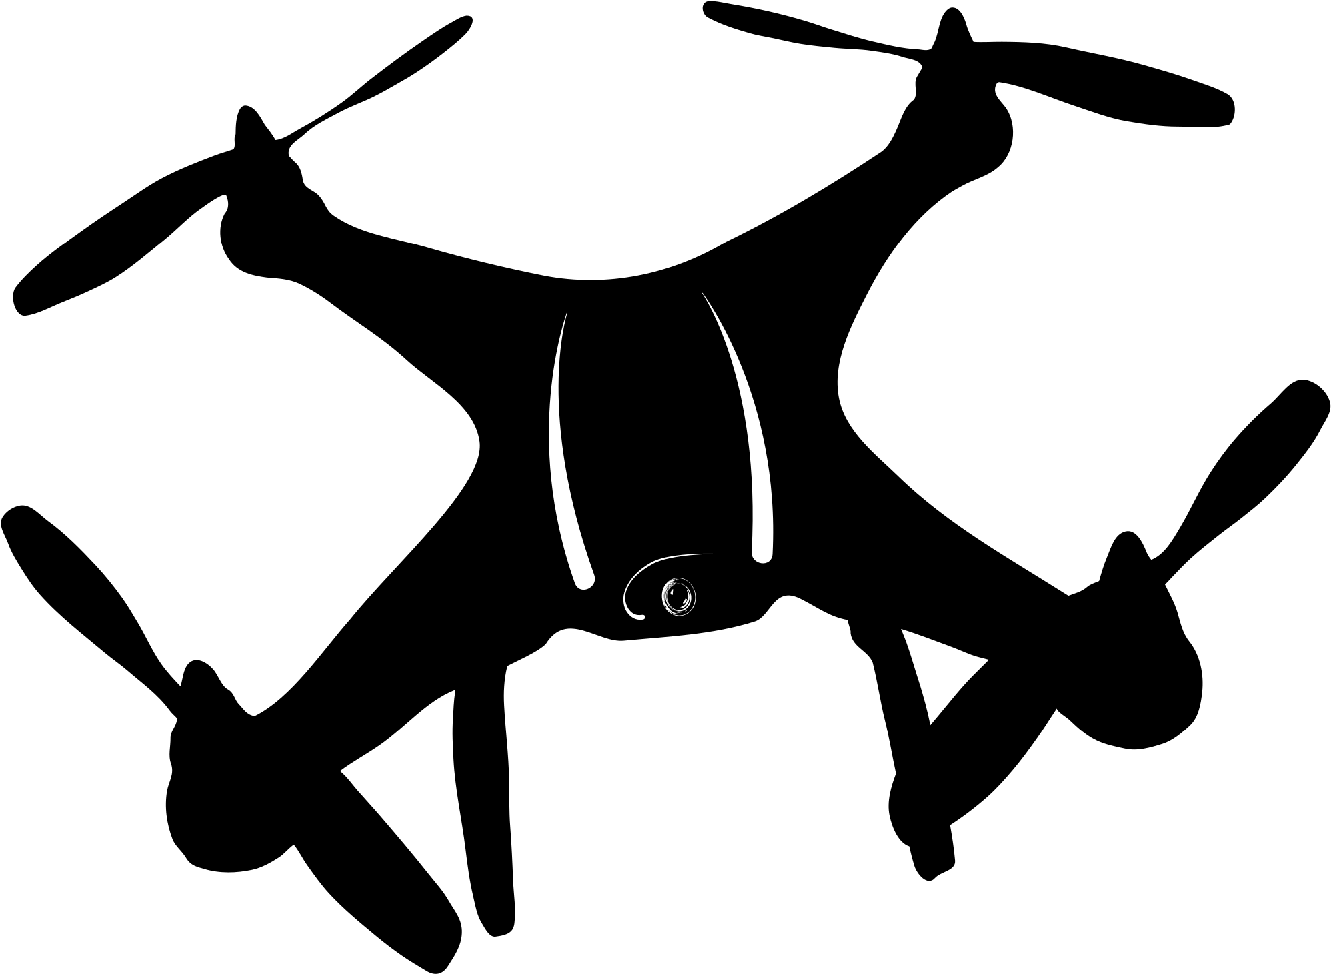
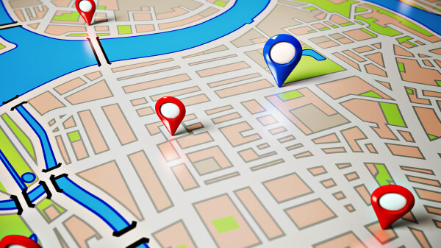


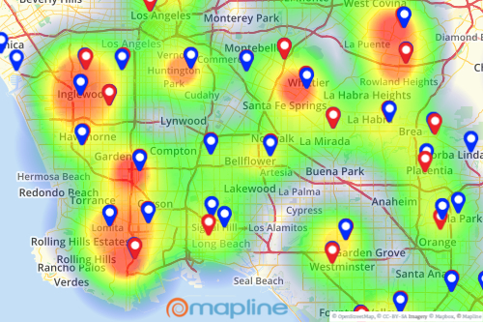


How it works?
eMohalla
Real-time image collection & tracking
Big-Data Analytics
AI recommender system
Sentiment Analytics
(for Government)
Real-time GPS based alerting system
(for Citizens)
UPI based peer-to-peer
e-transactions
AI based chatbot
(for Citizens)

Slide 6
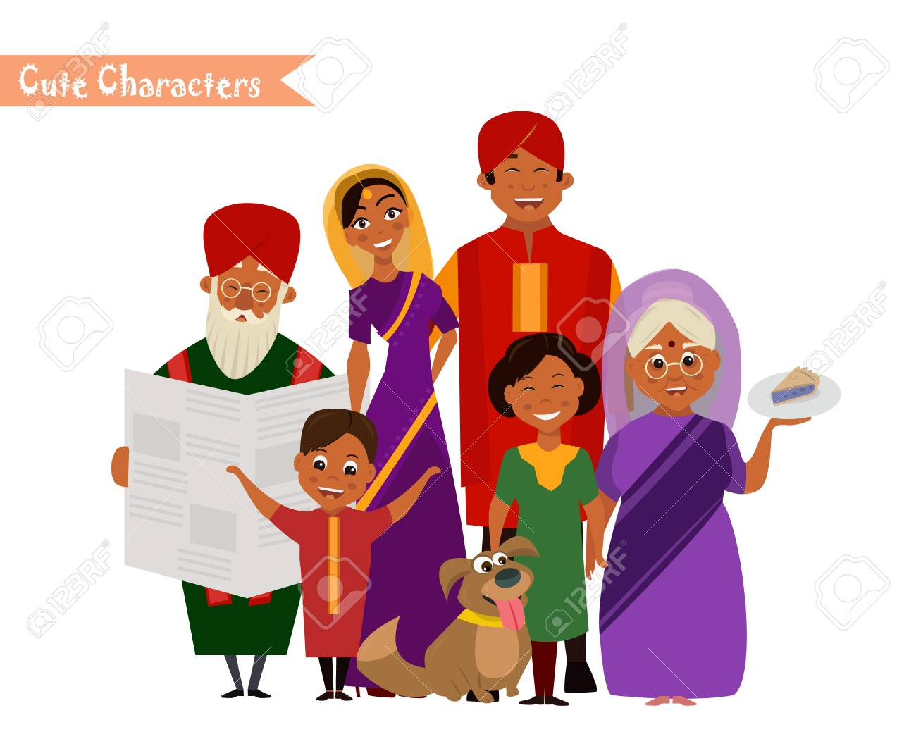

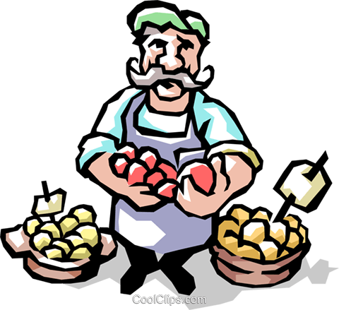
Who is it for? What does it do?
Detect lockdown violations, crowds, garbage in real-time
Map with high-risk areas
Hear peoples’ needs, concerns, sentiments
Get actionable suggestions
Use resources wisely
Navigational help on crowds &
Crowd-source violations, sanitization data
Supplies availability
Online transactions with street-vendors
Convey needs & concerns
Timely advice on precautions
Citizens
Shopkeepers
Government
Update status of stocks, shop open/close status
Online transactions with people around (UPI enabled)
Understand peoples’ needs in real-time

Slide 7










Architecture & Technologies
IBM Watson Assistant Service
UI
Image Capture
Browser
API
IBM Visual Recognition Service
User
App

Slide 8
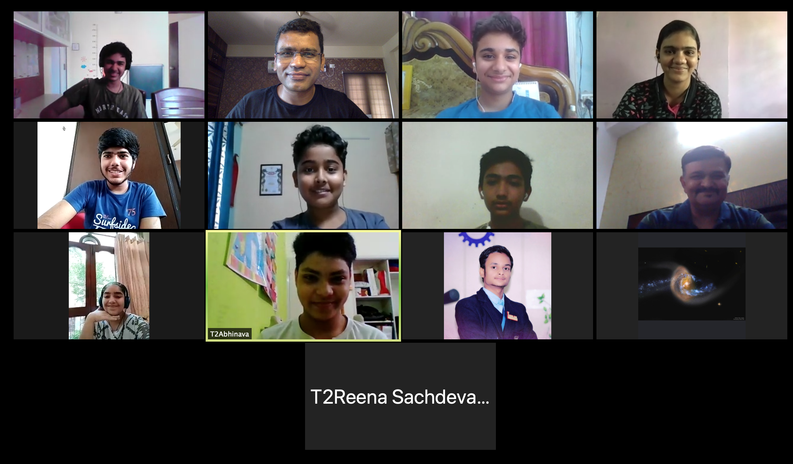
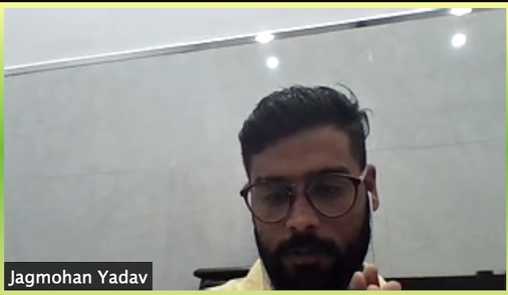
Samosa Sena’s Show Time

